Slide 1
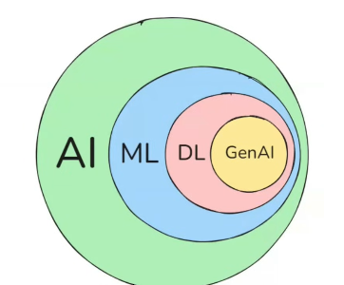
π
π

Slide 2
OpenAI
Gemini
Large
language
Model
oLlama
LLM
midjourney
AI
ML
DL
GenAI
Diff
Dall-E
Large
language
Model
Stable
Diffusion
Notes:
Content: https://www.linkedin.com/pulse/chunking-strategies-ai-data-kash-kashyap-0lghe/

Slide 3
π
Foundational Model
https://www.youtube.com/watch?v=f8HnIKsRcS8&list=PLXSkStXql1F4ZZVJ2laU-62WT3bgn_yLU&index=5
Notes:
Content: https://www.linkedin.com/pulse/chunking-strategies-ai-data-kash-kashyap-0lghe/

Slide 4
π
Notes:
Content: https://www.linkedin.com/pulse/chunking-strategies-ai-data-kash-kashyap-0lghe/

Slide 5
π
Notes:
Content: https://www.linkedin.com/pulse/chunking-strategies-ai-data-kash-kashyap-0lghe/

Slide 6
π
Notes:
Content: https://www.linkedin.com/pulse/chunking-strategies-ai-data-kash-kashyap-0lghe/

Slide 7
π
Notes:
Content: https://www.linkedin.com/pulse/chunking-strategies-ai-data-kash-kashyap-0lghe/

